Slide 1
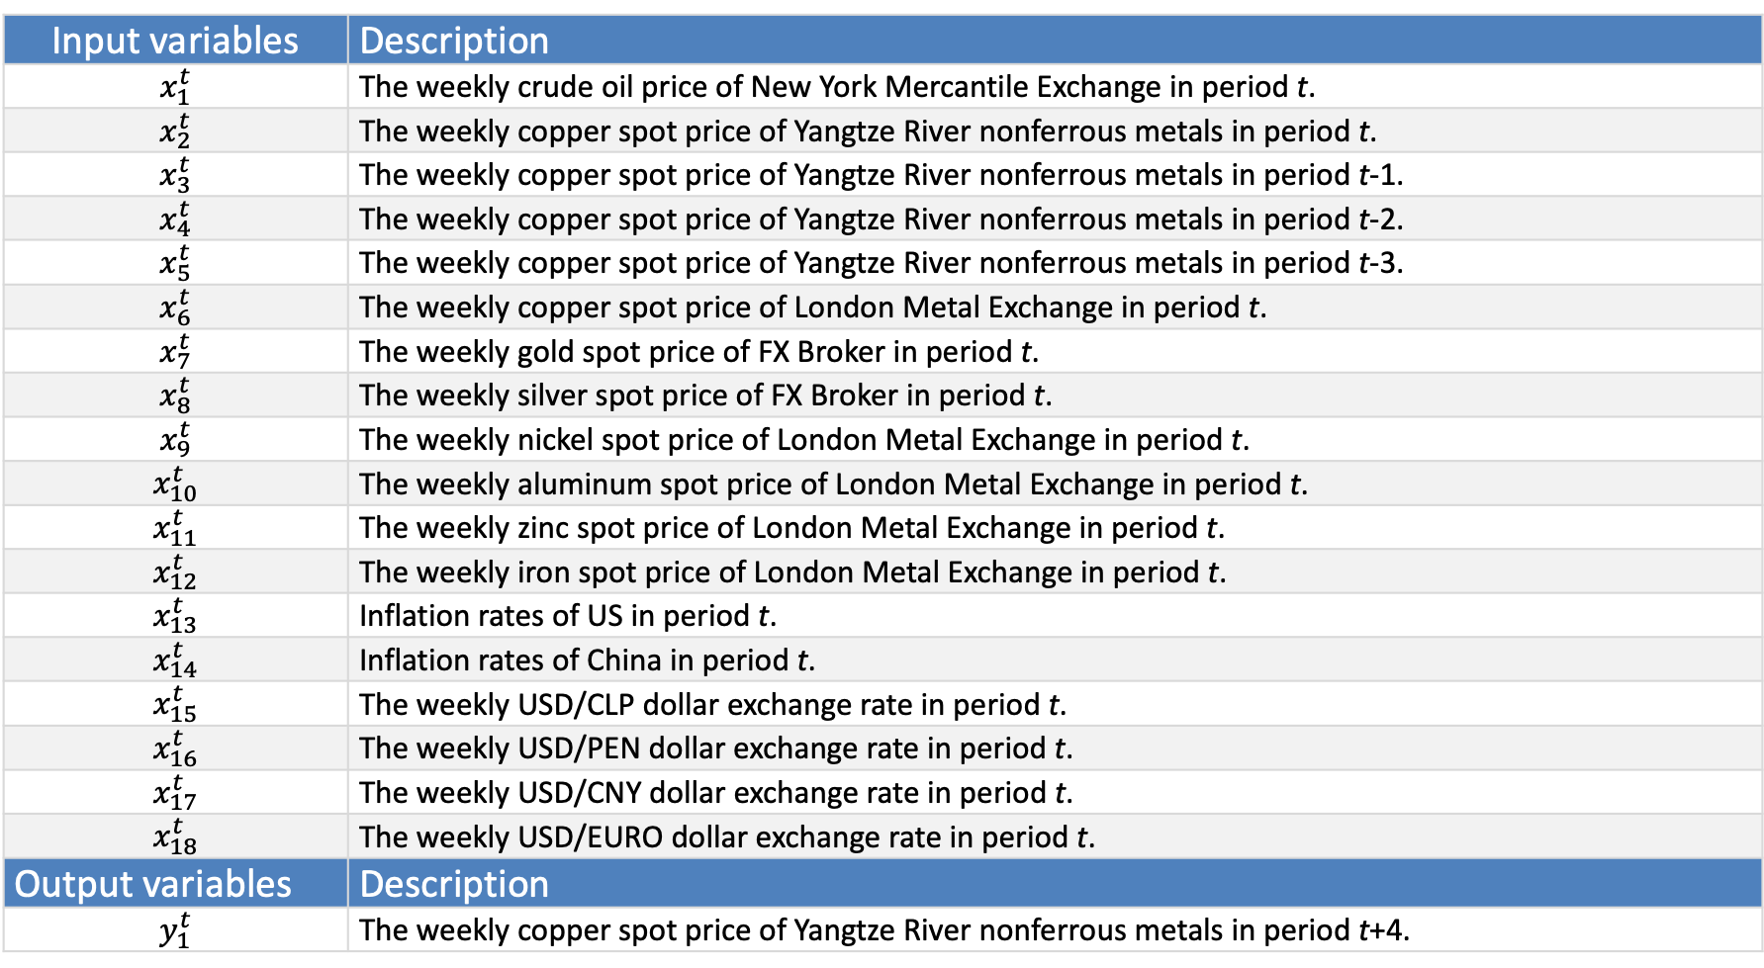
Dependent/independent variable description
Input variables | Description
$$x_{1}^{t}$$ | The weekly crude oil price of New York Mercantile Exchange in period t.
$$x_{2}^{t}$$ | The weekly copper spot price of Yangtze River nonferrous metals in period t.
$$x_{3}^{t}$$ | The weekly copper spot price of Yangtze River nonferrous metals in period t-1.
$$x_{4}^{t}$$ | The weekly copper spot price of Yangtze River nonferrous metals in period t-2.
$$x_{5}^{t}$$ | The weekly copper spot price of Yangtze River nonferrous metals in period t-3.
$$x_{6}^{t}$$ | The weekly copper spot price of London Metal Exchange in period t.
$$x_{7}^{t}$$ | The weekly gold spot price of FX Broker in period t.
$$x_{8}^{t}$$ | The weekly silver spot price of FX Broker in period t.
$$x_{9}^{t}$$ | The weekly nickel spot price of London Metal Exchange in period t.
$$x_{10}^{t}$$ | The weekly aluminum spot price of London Metal Exchange in period t.
$$x_{11}^{t}$$ | The weekly zinc spot price of London Metal Exchange in period t.
$$x_{12}^{t}$$ | The weekly iron spot price of London Metal Exchange in period t.
$$x_{13}^{t}$$ | Inflation rates of US in period t.
$$x_{14}^{t}$$ | Inflation rates of China in period t.
$$x_{15}^{t}$$ | The weekly USD/CLP dollar exchange rate in period t.
$$x_{16}^{t}$$ | The weekly USD/PEN dollar exchange rate in period t.
$$x_{17}^{t}$$ | The weekly USD/CNY dollar exchange rate in period t.
$$x_{18}^{t}$$ | The weekly USD/EURO dollar exchange rate in period t.
Output variables | Description
$$y_{1}^{t}$$ | The weekly copper spot price of Yangtze River nonferrous metals in period t+4.

